Slide 1
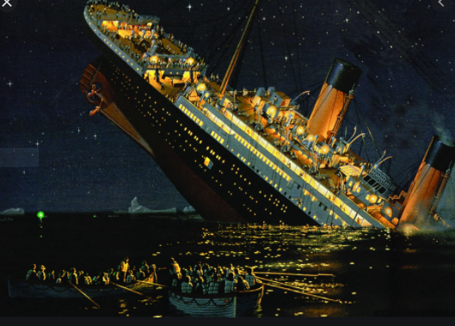
Titanic project
Owner Mohit kumar

